Slide 1
Linear discriminant analysis
Joanna Wyrobek
http://personal.psu.edu/jol2/course/stat597e/notes2/lda.pdf
https://sebastianraschka.com/Articles/2014_python_lda.html
https://www.youtube.com/watch?v=azXCzI57Yfc

Slide 2
Discriminant Analysis
It is used as a dimensionality reduction technique.
Also known as a commonly used in the pre-processing step in machine learning and pattern classification projects.
It is used as a dimensionality reduction technique. Also known as a commonly used in the pre-processing step in machine learning and pattern classification projects.
In Python, it helps to reduce high-dimensional data set onto a lower-dimensional space. The goal is to do this while having a decent separation between classes and reducing resources and costs of computing.
Original technique that was developed was known as the Linear Discriminant or Fisher’s Discriminant Analysis. This was a two-class technique. The multi-class version, as generalized by C.R. Rao, was called Multiple Discriminant Analysis.

Slide 3
Sometimes one feature does not let to divide the sample into 2 parts
Intensity of feature X

Slide 4
Using 2 features does a better job (still not perfect)
Intensity of feature Y
Intensity of feature X

Slide 5
Using 3 features allows for perfect separation
Intensity of feature Y
Intensity of feature X
5

Slide 6
For 4 dimentions we cannot draw it
LDA reduces dimentions by focusing on separability between classes

Slide 7
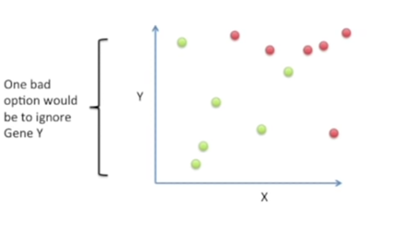
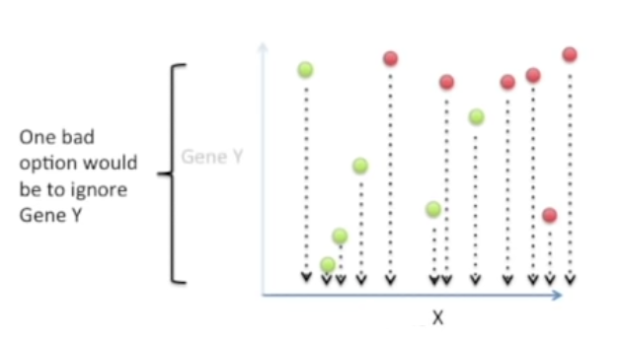
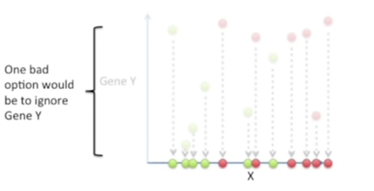
Reduction of dimensions example
We still cannot separate red dots from green dots after such casting of 2D space into 1D space – feature Y contained useful information which we ingored

Slide 8
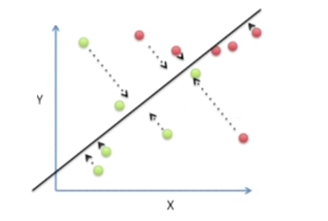
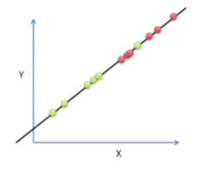
Reduction of dimenstions example
When we casted 2D space into 1D space with another axis, we get a better (although not perfect) separation between red dots and geen dots.

Slide 9
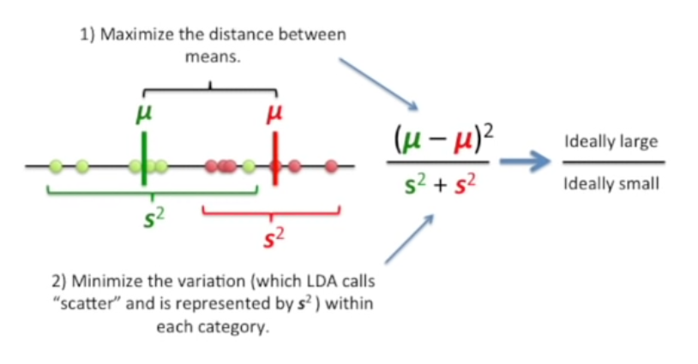
How LDA does this reduction of dimensions (creates a new axis)

Slide 10
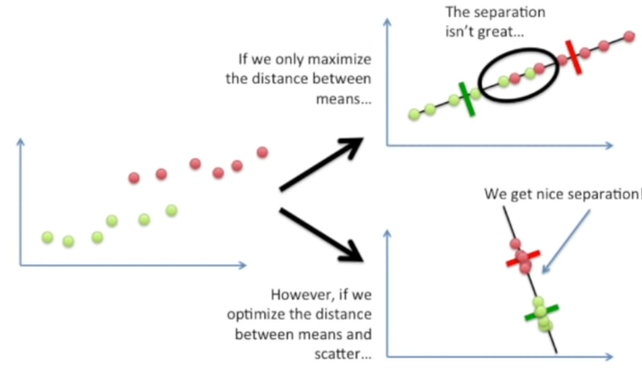
Why both the distance and scatter are important

Slide 11
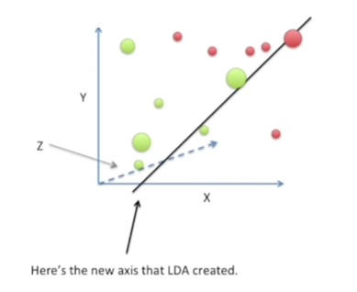
What if we have more than 2 dimensions?
Still we create a new axis that minimizes the distance between the means for the two categories while minimizing the scatter

Slide 12
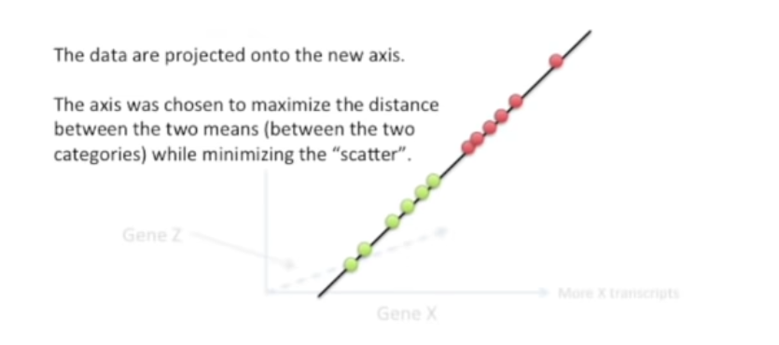
What if we have more than 2 dimensions?

Slide 13
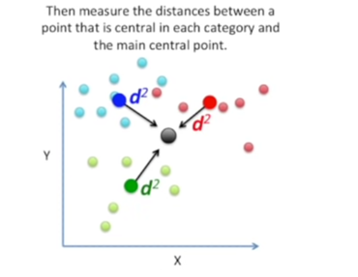
What if we have 3 categories?
We measure differently distances between among the classes’ means
We firstly find the central point for all the data (average of coordinates of all the points from all classes)
Then we measure distances between the point that is central to each cathegory to the main central point

Slide 14
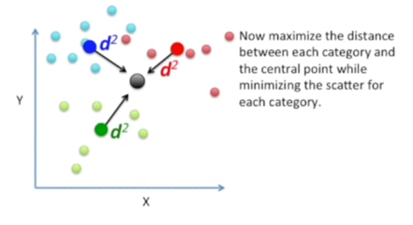
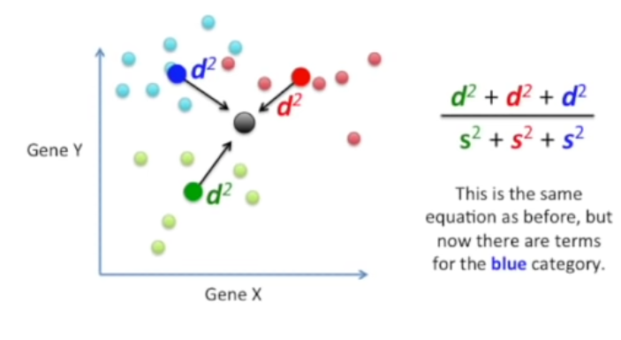
What if there are 3 cathegories?

Slide 15
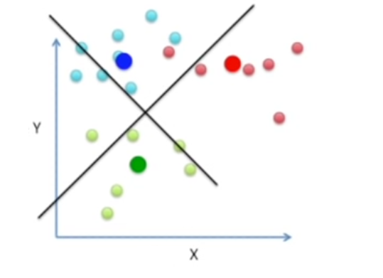
What if we have 3 cathegories?
To separate 3 types of points we need 2 axes
This is because 3 central points for each cathegory define a plane

Slide 16
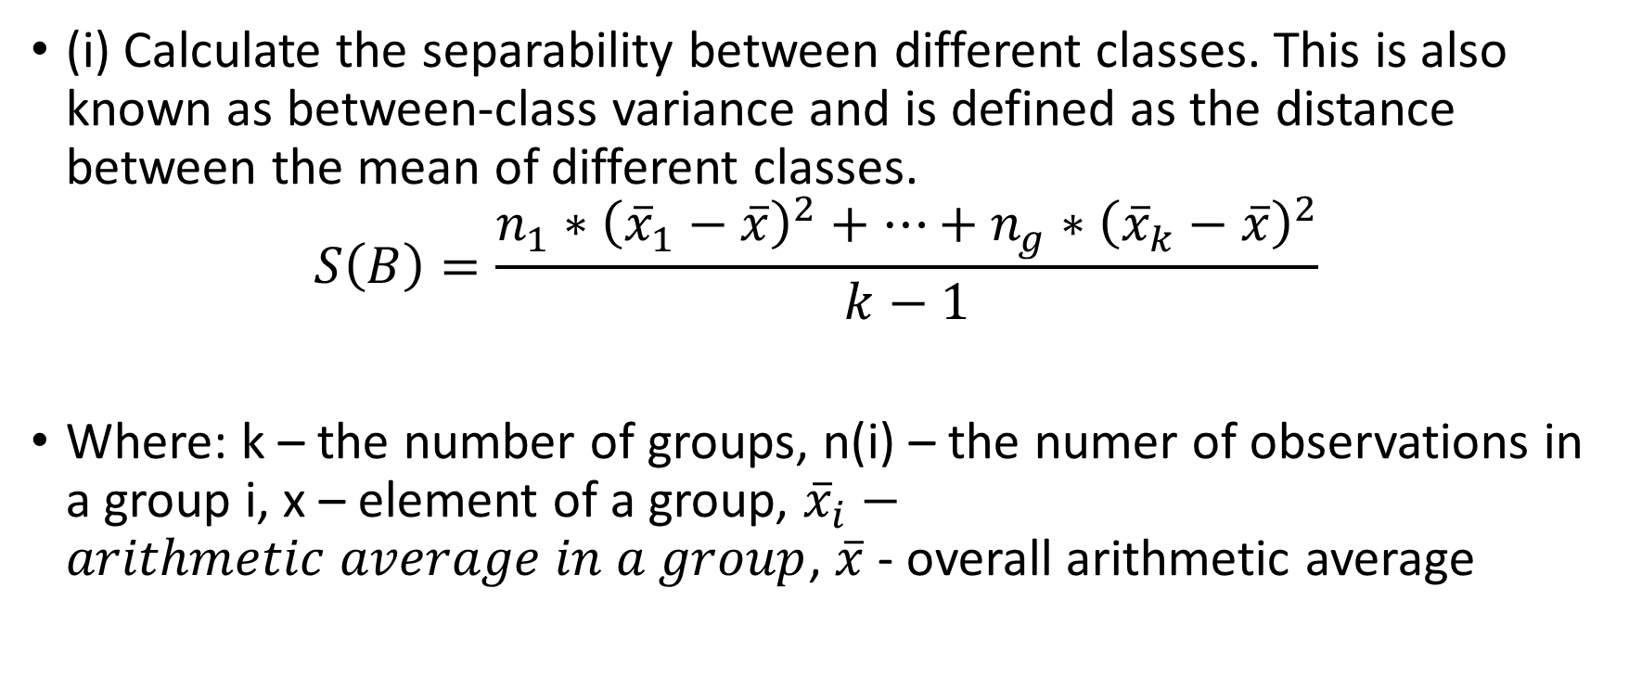
Linear discriminant analysis algorithm
(i) Calculate the separability between different classes. This is also known as between-class variance and is defined as the distance between the mean of different classes.
$$S\left(B\right)=\frac{n_{1}∗{\left({\overline{x}}_{1}−\overline{x}\right)}^{2}+…+n_{g}∗{\left({\overline{x}}_{k}−\overline{x}\right)}^{2}}{k−1}$$
Where: k – the number of groups, n(i) – the numer of observations in a group i, x – element of a group, ${\overline{x}}_{i}−arithmetic average in a group$, $\overline{x}$ - overall arithmetic average

Slide 17
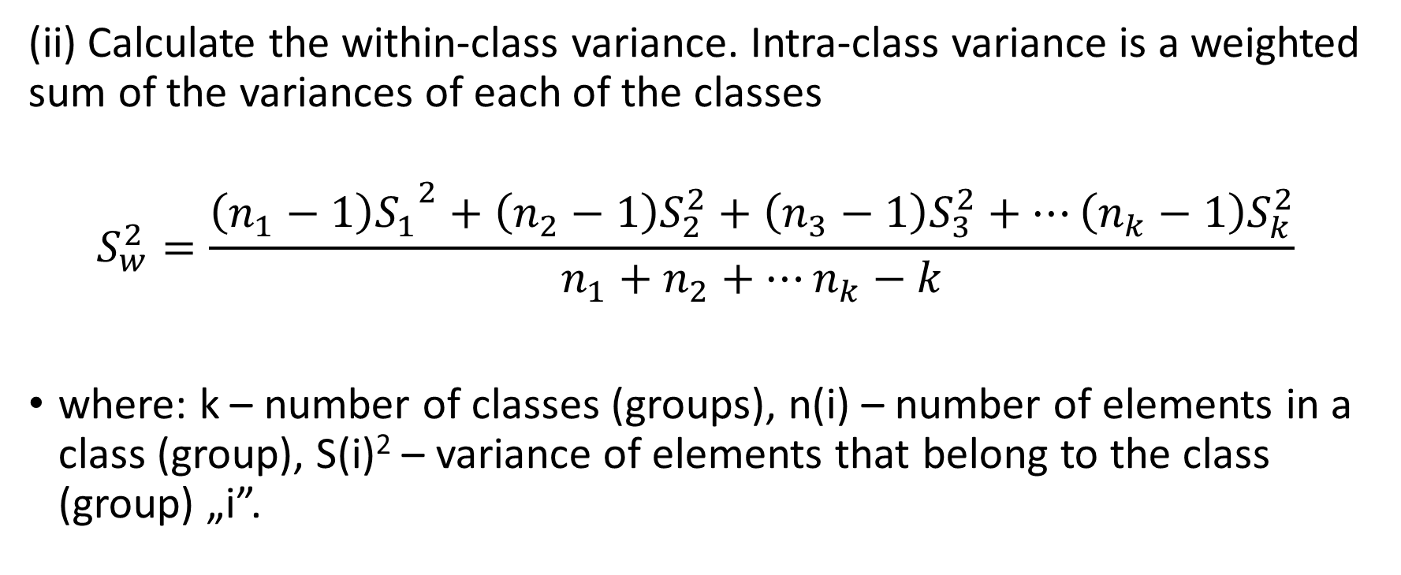
Linear discriminant analysis algorithm
(ii) Calculate the within-class variance. Intra-class variance is a weighted sum of the variances of each of the classes
$$S_{w}^{2}=\frac{{\left(n_{1}−1\right)S_{1}}^{2}+\left(n_{2}−1\right)S_{2}^{2}+\left(n_{3}−1\right)S_{3}^{2}+…\left(n_{k}−1\right)S_{k}^{2}}{n_{1}+n_{2}+…n_{k}−k}$$
where: k – number of classes (groups), n(i) – number of elements in a class (group), S(i)² – variance of elements that belong to the class (group) „i”.

Slide 18
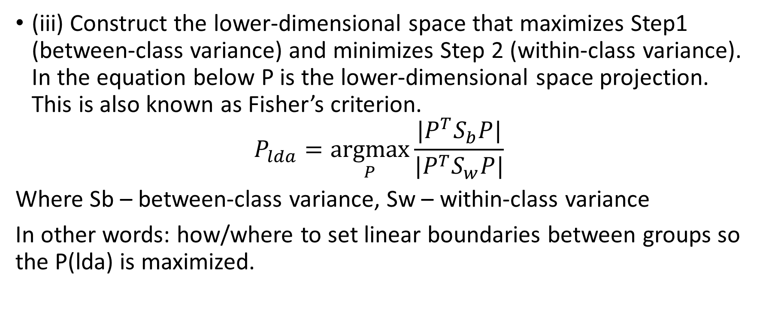
Linear discriminant analysis algorithm
(iii) Construct the lower-dimensional space that maximizes Step1 (between-class variance) and minimizes Step 2 (within-class variance). In the equation below P is the lower-dimensional space projection. This is also known as Fisher’s criterion.
$$P_{lda}=\underset{P}{argmax}{\frac{|P^{T}S_{b}P|}{{|P}^{T}S_{w}P|}}$$
Where Sb – between-class variance, Sw – within-class variance
In other words: how/where to set linear boundaries between groups so the P(lda) is maximized.

Slide 19
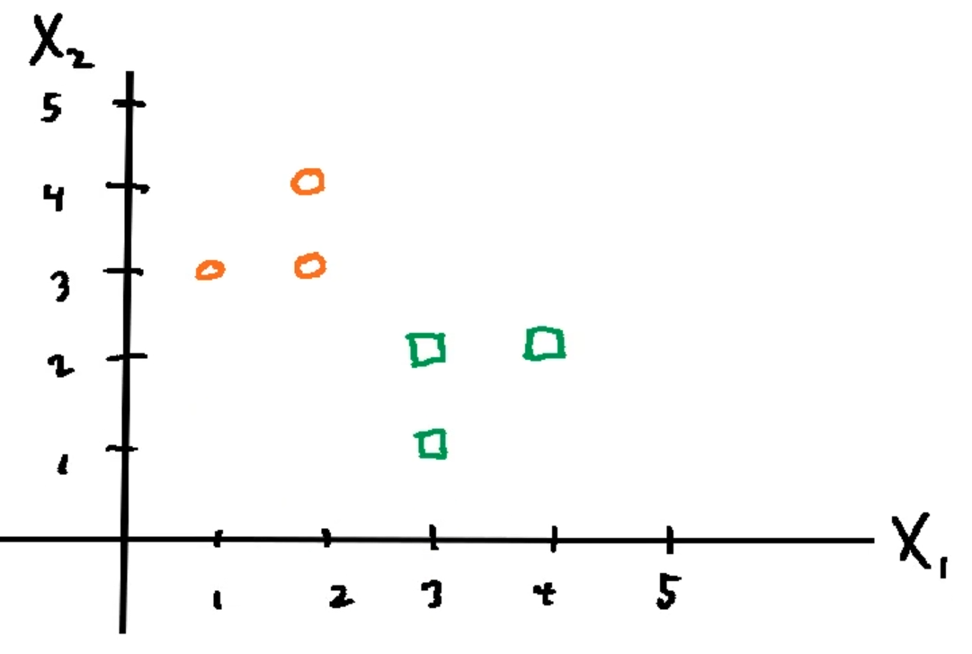
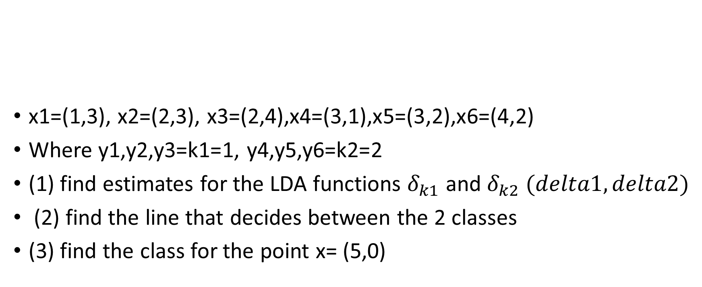
LDA example 1
x1=(1,3), x2=(2,3), x3=(2,4),x4=(3,1),x5=(3,2),x6=(4,2)
Where y1,y2,y3=k1=1, y4,y5,y6=k2=2
(1) find estimates for the LDA functions $δ_{k1}$ and $δ_{k2} (delta1, delta2)$
(2) find the line that decides between the 2 classes
(3) find the class for the point x= (5,0)

Slide 20
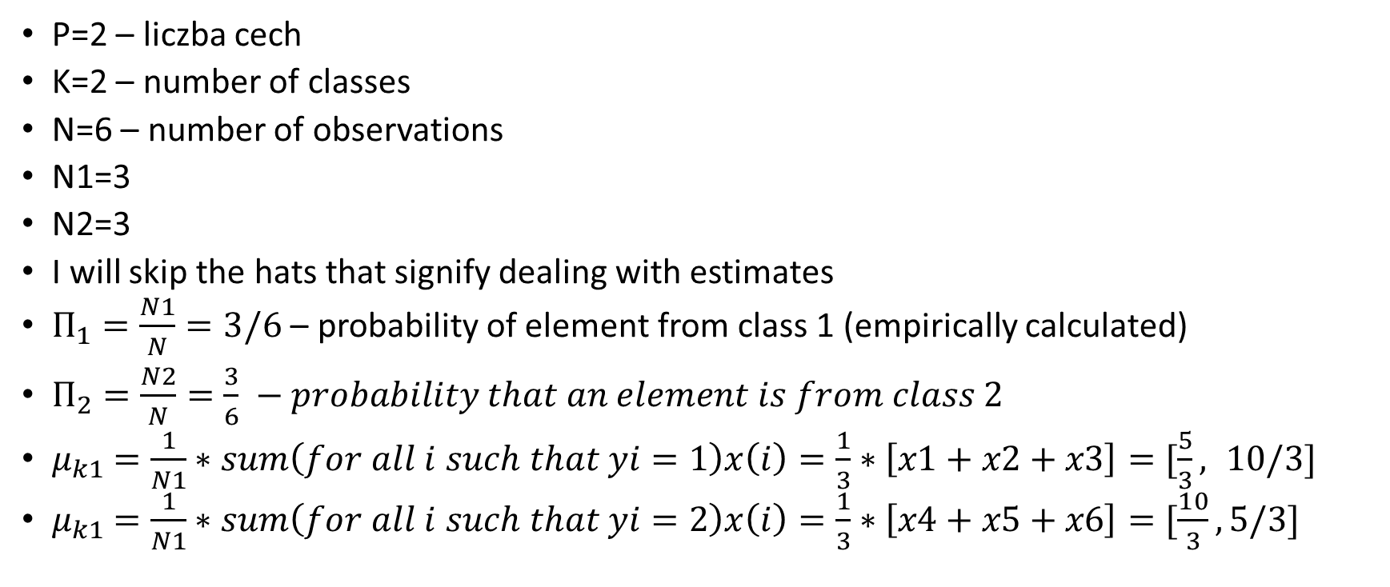
LDA example 1
P=2 – liczba cech
K=2 – number of classes
N=6 – number of observations
N1=3
N2=3
I will skip the hats that signify dealing with estimates
$Π_{1}=\frac{N1}{N}=3/6$ – probability of element from class 1 (empirically calculated)
$Π_{2}=\frac{N2}{N}=\frac{3}{6} −probability that an element is from class 2$
$μ_{k1}$ $=\frac{1}{N1}∗sum\left(for all i such that yi=1\right)x\left(i\right)=\frac{1}{3}∗\left[x1+x2+x3\right]=[\frac{5}{3}, 10/3]$
$μ_{k1}$ $=\frac{1}{N1}∗sum\left(for all i such that yi=2\right)x\left(i\right)=\frac{1}{3}∗\left[x4+x5+x6\right]=[\frac{10}{3}, 5/3]$

Slide 21
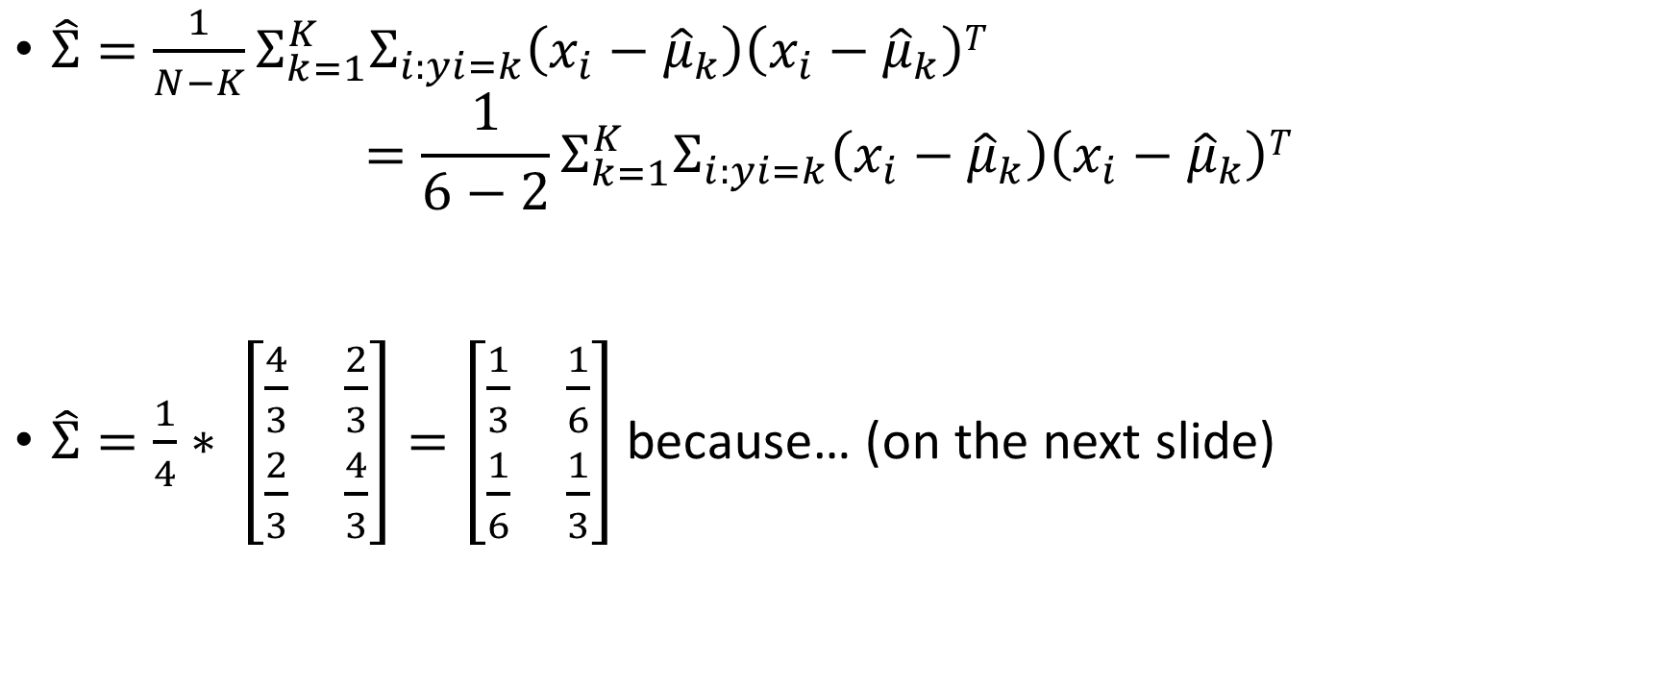
LDA example 1
$\hat{Σ}=\frac{1}{N−K}Σ_{k=1}^{K}Σ_{i:yi=k}\left(x_{i}−{\hat{μ}}_{k}\right)\left(x_{i}−{\hat{μ}}_{k}\right)T$ $=\frac{1}{6−2}Σ_{k=1}^{K}Σ_{i:yi=k}\left(x_{i}−{\hat{μ}}_{k}\right)\left(x_{i}−{\hat{μ}}_{k}\right)T$
$\hat{Σ}=\frac{1}{4}∗ \left[\begin{matrix}\frac{4}{3} & \frac{2}{3} \\ \frac{2}{3} & \frac{4}{3}\end{matrix}\right]=\left[\begin{matrix}\frac{1}{3} & \frac{1}{6} \\ \frac{1}{6} & \frac{1}{3}\end{matrix}\right]$ because… (on the next slide)

Slide 22
Because…
Class | x | y | avX | Av Y |  | X-avX | Y-avY |  | transposed | X-avX | Y-avY | product | product
1 | 1 | 3 | 1.666667 | 3.333333 |  | -0.66667 | -0.33333 |  | -0.66667 |  |  | 0.444444 | 0.222222
1 | 2 | 3 |  |  |  | 0.333333 | -0.33333 |  | -0.33333 | -0.66667 | -0.33333 | 0.222222 | 0.111111
1 | 2 | 4 |  |  |  | 0.333333 | 0.666667
2 | 3 | 1 | 3.333333 | 1.666667 |  | -0.33333 | -0.66667 |  | 0.333333 |  |  | 0.111111 | -0.11111
2 | 3 | 2 |  |  |  | -0.33333 | 0.333333 |  | -0.33333 | 0.333333 | -0.33333 | -0.11111 | 0.111111
2 | 4 | 2 |  |  |  | 0.666667 | 0.333333 |  |  |  |  |  |  |  | subtotal | Class 1
 |  |  |  |  |  |  |  |  | 0.333333 |  |  | 0.111111 | 0.222222 |  | 0.666667 | 0.333333
 |  |  |  |  |  |  |  |  | 0.666667 | 0.333333 | 0.666667 | 0.222222 | 0.444444 |  | 0.333333 | 0.666667
 |  |  |  |  |  |  |  |  | -0.33333 |  |  | 0.111111 | 0.222222
 |  |  |  |  |  |  |  |  | -0.66667 | -0.33333 | -0.66667 | 0.222222 | 0.444444
 |  |  |  |  |  |  |  |  | -0.33333 |  |  | 0.111111 | -0.11111
 |  |  |  |  |  |  |  |  | 0.333333 | -0.33333 | 0.333333 | -0.11111 | 0.111111
 |  |  |  |  |  |  |  |  |  |  |  |  |  |  | subtotal | Class 2
 |  |  |  |  |  |  |  |  | 0.666667 |  |  | 0.444444 | 0.222222 |  | 0.666667 | 0.333333
 |  |  |  |  |  |  |  |  | 0.333333 | 0.666667 | 0.333333 | 0.222222 | 0.111111 |  | 0.333333 | 0.666667
 |  |  |  |  |  |  |  |  |  |  |  |  |  |  | TOTAL | TOTAL
 |  |  |  |  |  |  |  |  |  |  |  |  |  |  | 1.333333 | 0.666667
 |  |  |  |  |  |  |  |  |  |  |  |  |  |  | 0.666667 | 1.333333

Slide 23
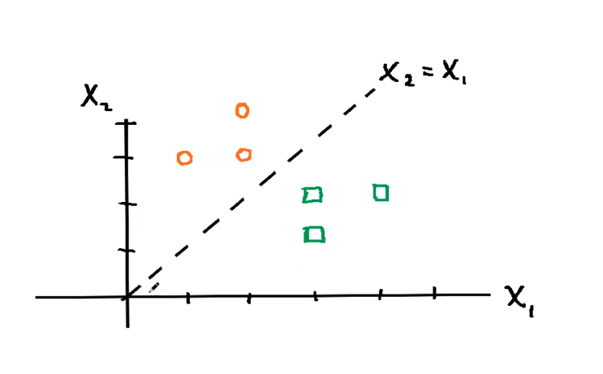
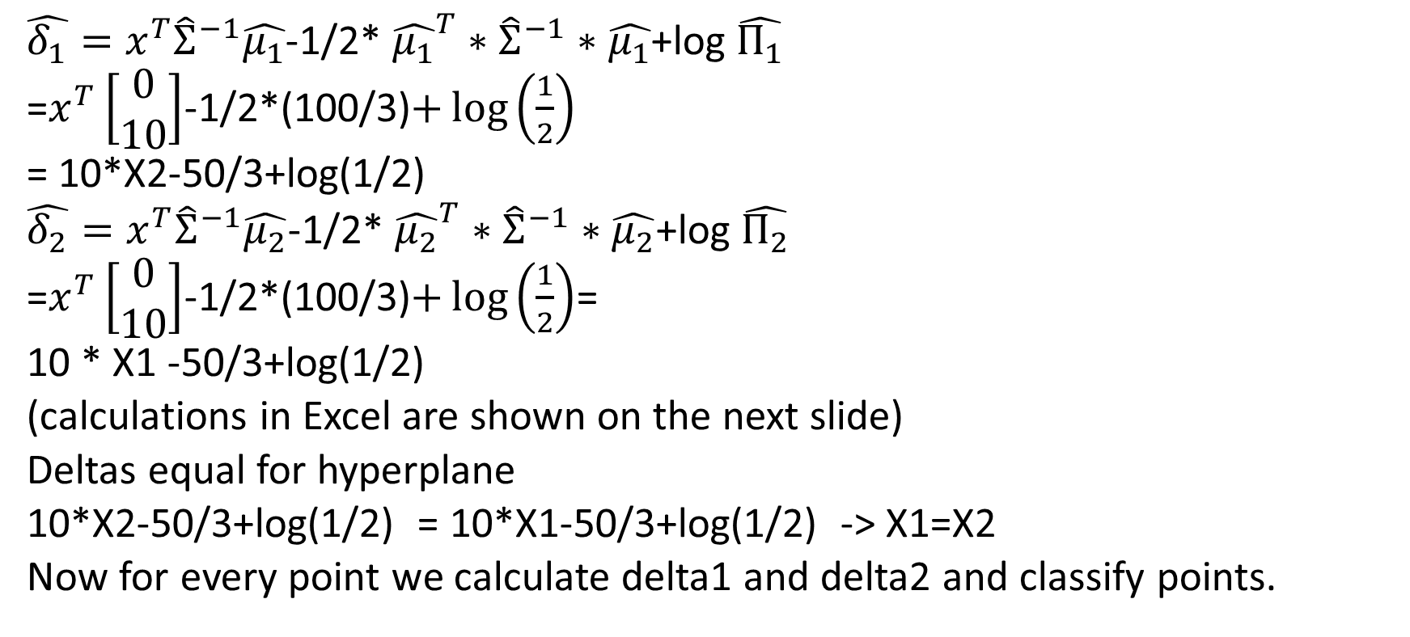
LDA example 1
$\hat{δ_{1}}=x^{T}{\hat{Σ}}^{−1}\hat{μ_{1}}$-1/2* ${\hat{μ_{1}}}^{T}∗{\hat{Σ}}^{−1}∗\hat{μ_{1}}$+log $\hat{Π_{1}}$
=$x^{T}\left[\begin{matrix}0 \\ 10\end{matrix}\right]$-1/2*(100/3)$+\log\left(\frac{1}{2}\right)$
= 10*X2-50/3+log(1/2)
$\hat{δ_{2}}=x^{T}{\hat{Σ}}^{−1}\hat{μ_{2}}$-1/2* ${\hat{μ_{2}}}^{T}∗{\hat{Σ}}^{−1}∗\hat{μ_{2}}$+log $\hat{Π_{2}}$
=$x^{T}\left[\begin{matrix}0 \\ 10\end{matrix}\right]$-1/2*(100/3)$+\log\left(\frac{1}{2}\right)$=
10 * X1 -50/3+log(1/2)
(calculations in Excel are shown on the next slide)
Deltas equal for hyperplane
10*X2-50/3+log(1/2) = 10*X1-50/3+log(1/2) -> X1=X2
Now for every point we calculate delta1 and delta2 and classify points.

Slide 24
Discriminant function 1 calculation

Slide 25
Discriminant function 2 calculation

Slide 26
LDA example 2
Curvature | Diameter | Quality Control Result
2.95 | 6.63 | 1
2.53 | 7.79 | 1
3.57 | 5.65 | 1
3.16 | 5.47 | 1
2.58 | 4.46 | 0
2.16 | 6.22 | 0
3.27 | 3.52 | 0
2.888571 | 5.677143
Factory "ABC" produces very expensive and high quality chip rings that their qualities are measured in term of curvature and diameter. Result of quality control by experts is given in the table above.
As a consultant to the factory, you get a task to set up the criteria for automatic quality control.
Then, the manager of the factory also wants to test your criteria upon new type of chip rings that even the human experts are argued to each other.
The new chip rings have curvature 2.81 and diameter 5.46.
Can you solve this problem by employing Discriminant Analysis?

Slide 27
LDA example 2
When we plot the features, we can see that the data is linearly separable.
We can draw a line to separate the two groups.
The problem is to find the line and to rotate the features in such a way to maximize the distance between groups and to minimize distance within group.
x = features (or independent variables) of all data. Each row (denoted by * ) represents one object; each column stands for one feature.
y = group of the object (or dependent variable) of all data. Each row represents one object and it has only one column.

Slide 28
LDA example 2
 | 2.95 | 6.63 |  |  | 1
 | 2.53 | 7.79 |  |  | 1
X = | 3.57 | 5.65 |  |  | 1
 | 3.16 | 5.47 |  | y = | 1
 |  |  |  |  | 0
 |  |  |  |  | 0
 |  |  |  |  | 0
g - number of groups in y , in our example, g = 2
x(i,.) features data for group i
Each row represents one object, each column stands for one feature
We separate x into several groups based on the number of category in y
x(.,k) is the data row, for example x(3) = 3.57 5.65

Slide 29
LDA example 2
 | 2.95 | 6.63
 | 2.53 | 7.79 |  |  | 2.58 | 4.46
x(1) = | 3.57 | 5.65 |  | x(2) = | 2.16 | 6.22
 | 3.16 | 5.47 |  |  | 3.27 | 3.52
 | 2.95 | 2.53 | 3.57 | 3.16 |  |  | 2.58 | 2.16 | 3.27
x(1)T = | 6.63 | 7.79 | 5.65 | 5.47 |  | x(2)T= | 4.46 | 6.22 | 3.52

Slide 30
LDA example
m(i) - mean of features in group i which is average of x(i)
m(1) = | 3.0525 | 6.385
m(2) = | 2.67 | 4.733333
m(1)+m(2)= | 5.7225 | 11.11833
m(1)-m(2) | 0.3825 | 1.651667
m - global mean vector that is the mean of the whole data set
m = | 2.888571 | 5.677143

Slide 31
LDA example 2
x(i, fi) - mean corrected data that is the features data for group i, x(i) minus the global mean vector m
 | 0.061429 | 0.952857
 | -0.35857 | 2.112857 |  |  | -0.30857 | -1.21714
x(1, fi) = | 0.681429 | -0.02714 |  | x(2,fi) = | -0.72857 | 0.542857
 | 0.271429 | -0.20714 |  |  | 0.381429 | -2.15714
 | 0.061429 | -0.35857 | 0.681429 | 0.271429 |  | 4
x(1,fi)T = | 0.952857 | 2.112857 | -0.02714 | -0.20714
x(2,fi)T= | -0.30857 | -0.72857 | 0.381429 |  |  | 3
 | -1.21714 | 0.542857 | -2.15714

Slide 32
LDA example 2
 | x(i,fi)T*x(fi,i)
c(i) = | ------------------------------------ |  |  | covariance matrix of group i
 | n(i)
c(1) = | 0.167591 | -0.19345 |  | covariance for group 1
 | -0.19345 | 1.353937
c(2) = | 0.257173 | -0.28091 |  | covariance for group 2
 | -0.28091 | 2.143132

Slide 33
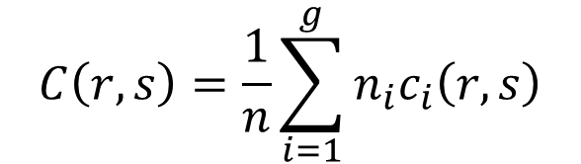
LDA example 2
$$C\left(r,s\right)=\frac{1}{n}\sum_{i=1}^{g}{n_{i}c_{i}\left(r,s\right)}$$
pooled within group covariance matrix
It is calculated for each entry (r,s) in the matrix
In our example
`4/7* | 0.167591 | `+ | `3/7* | 0.257173 | = | 0.205984
`4/7* | -0.19345 |  | `3/7* | -0.28091 | = | -0.23093
`4/7* | -0.19345 |  | `3/7* | -0.28091 | = | -0.23093
`4/7* | 1.353937 |  | `3/7* | 2.143132 | = | 1.692163

Slide 34
LDA example 2
therefore:
C = | 0.205984 | -0.23093 |  | pooled within group variance
 | -0.23093 | 1.692163
 |  |  |  |  |  | 5.731714 | 0.782218
The inverse of the pooled covariance matrix is C(-1) = |  |  |  |  |  | 0.782218 | 0.69771 |  | inverse within group variance
P - | prior probability vector (each row represent prior probability of group i)
 | If we do not know the prior probability we just assume it is equal to total sample of each group divided by the total samples, that is p(i) = n(i) / N
P = | `4/7 | = | 0.571429
 | `3/7 |  | 0.428571

Slide 35
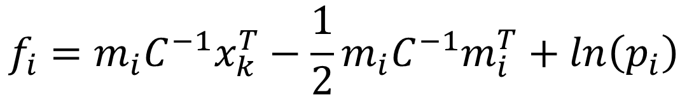
LDA example 2
$$f_{i}=m_{i}C^{−1}x_{k}^{T}−\frac{1}{2}m_{i}C^{−1}m_{i}^{T}+ln\left(p_{i}\right)$$
Discriminant functions

Slide 36
LDA example 2
$$f_{i}=m_{i}C^{−1}x_{k}^{T}−\frac{1}{2}m_{i}C^{−1}m_{i}^{T}+ln\left(p_{i}\right)$$
Discriminant functions

Slide 37
Let now f1 = f2

Slide 38
Border line
w = S * (m(1) - m(2))
w = | 3.484344
 | 1.451583
W(0)= | Ln(P1/P2) | -1/2*(m(1)-m(2))* | W^T
w(0) = | -17.7515
f = | -17.7515 | + | 3.484344 | * X1 + | 1.451583 | * X2

Slide 39
LDA example 2
We should assign object k to group i that has maximum f(i)
The results of our computation are given in Ms Excel as shown in figure below
We substitute points to the border line equation
Training data |  |  |  | Mean Corrected Data |  |  | Discriminant Function |  |  | Results |  | Other |  | Results |  | Classification
class | X1 | X2 |  | X1,0 | X2,0 |  | f1 | f2 |  | Classification |  | Classification |  | Classification |  | Error
1 | 2.95 | 6.63 |  | -0.12929 | 2.031429 |  | 54.98269 | 52.83137 |  | 1 |  | 2.151321 |  | 1 |  | a
1 | 2.53 | 7.79 |  | -0.54929 | 3.191429 |  | 53.47409 | 51.10236 |  | 1 |  | 2.371733 |  | 1 |  | a
1 | 3.57 | 5.65 |  | 0.490714 | 1.051429 |  | 62.22107 | 59.33201 |  | 1 |  | 2.889063 |  | 1 |  | a
1 | 3.16 | 5.47 |  | 0.080714 | 0.871429 |  | 51.76829 | 50.56909 |  | 1 |  | 1.199197 |  | 1 |  | a
2 | 2.58 | 4.46 |  | -0.49929 | -0.13857 |  | 31.81276 | 34.10058 |  | 2 |  | -2.28782 |  | 2 |  | c
2 | 2.16 | 6.22 |  | -0.91929 | 1.621429 |  | 34.40972 | 35.60618 |  | 2 |  | -1.19646 |  | 2 |  | C
2 | 3.27 | 3.52 |  | 0.190714 | -1.07857 |  | 40.89918 | 42.14729 |  | 2 |  | -1.24811 |  | 2 |  | C
prediction | 2.888571 | 5.677143 |  | -0.19071 | 1.078571 |  | 47.08111 | 46.52698 |  | 1 |  | 0.554132 |  | 1
average | 3.079286 | 4.598571
std dev | 0.269711 | 1.52533

Slide 40
Confusion matrix
 | Prediction
True Class | 1 | 2
1 | 4 | 0 | 4
2 | 0 | 3 | 3
 | 4 | 3 | 7
 | Prediction
True Class | 1 | 2
1 | 0.571429 | 0
2 | 0 | 0.428571

Slide 41
LDA in RapidMiner

Slide 42

Open a new (blank) process

Slide 43
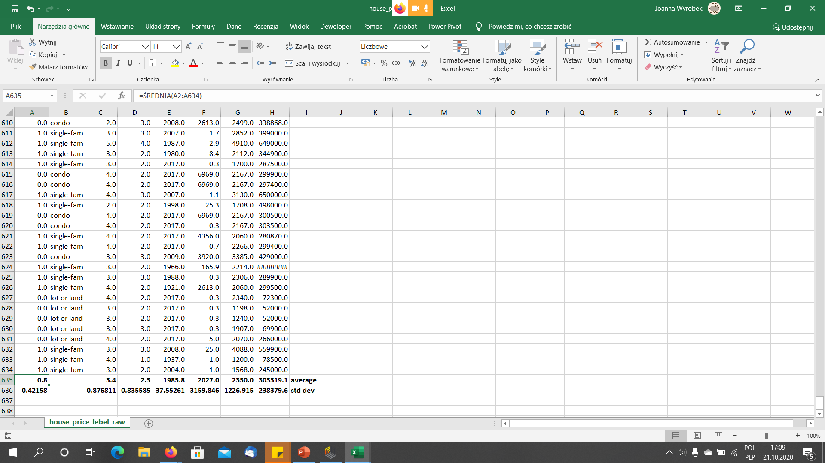
We will firstly normalize data set in Excel (house-price-label)

Slide 44
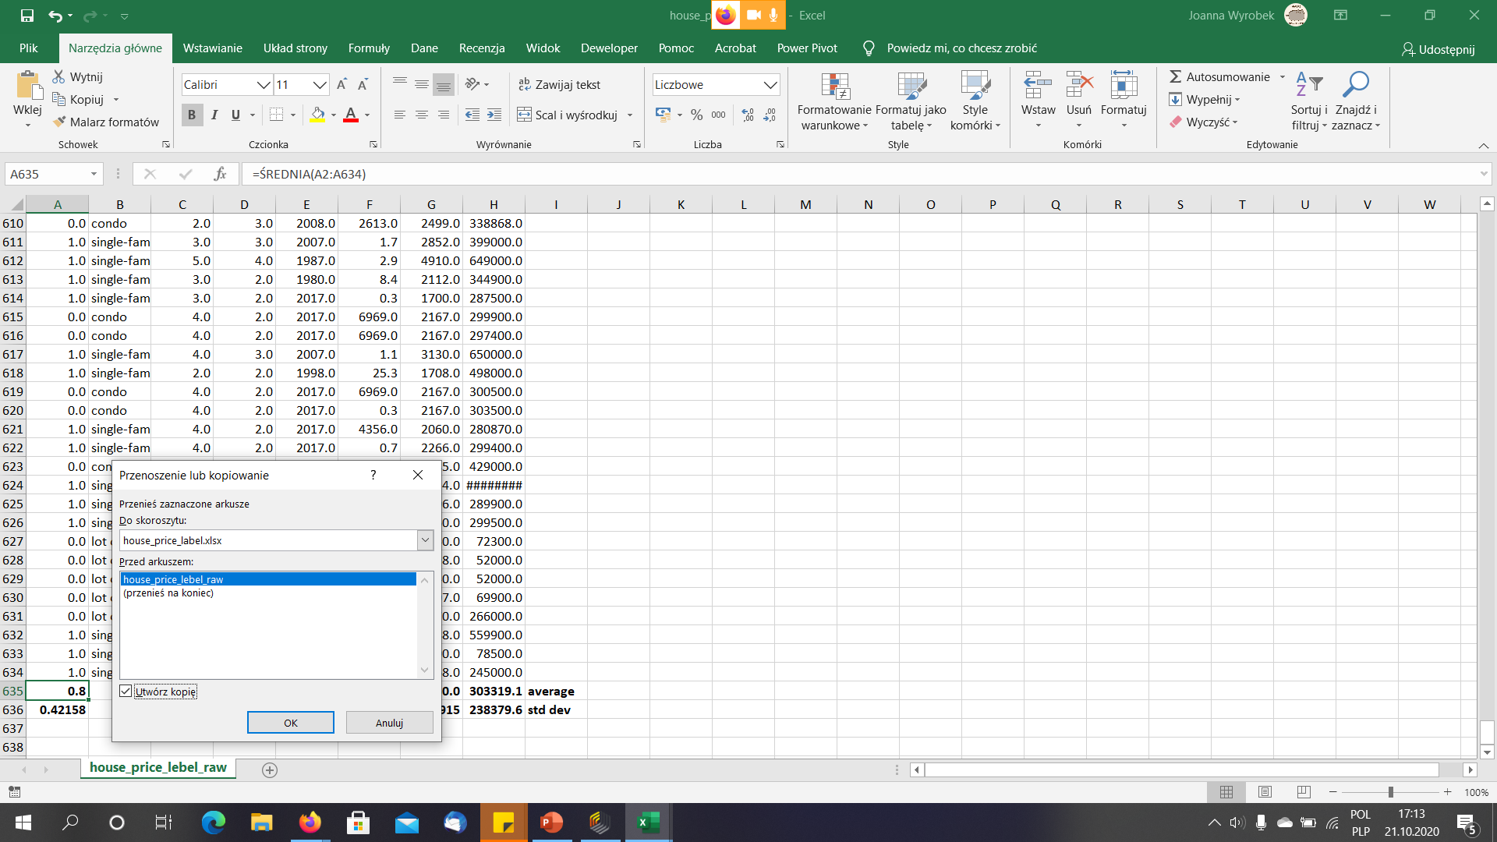
We will firstly normalize data set in Excel (house-price-label)
Make a copy of the spreadsheet and copy and paste as values the averages and standard deviations.

Slide 45
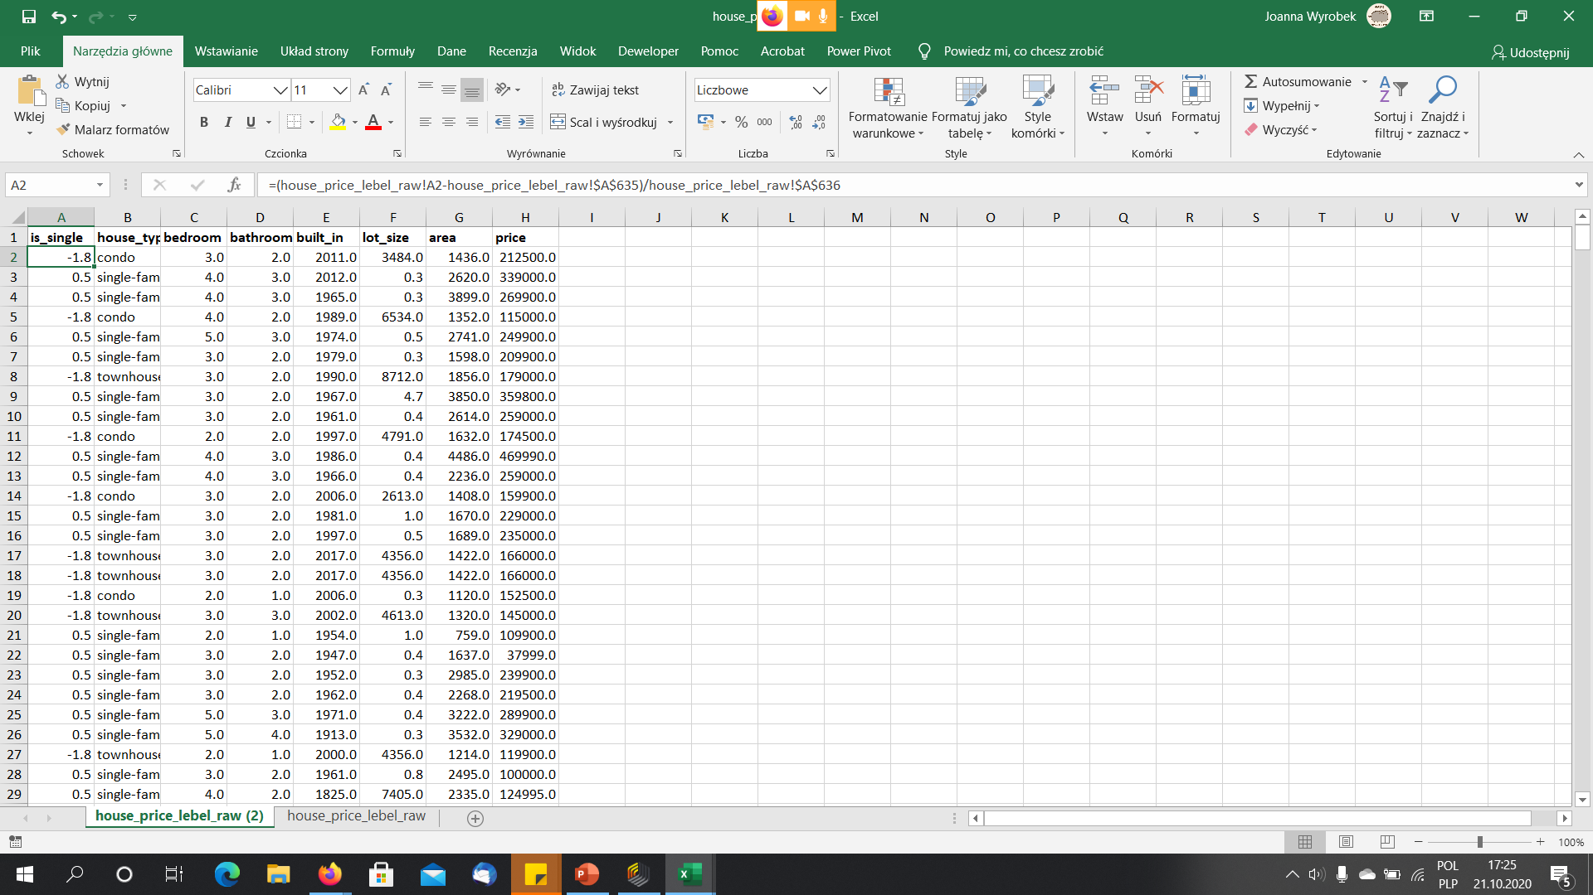
Apply standardization

Slide 46
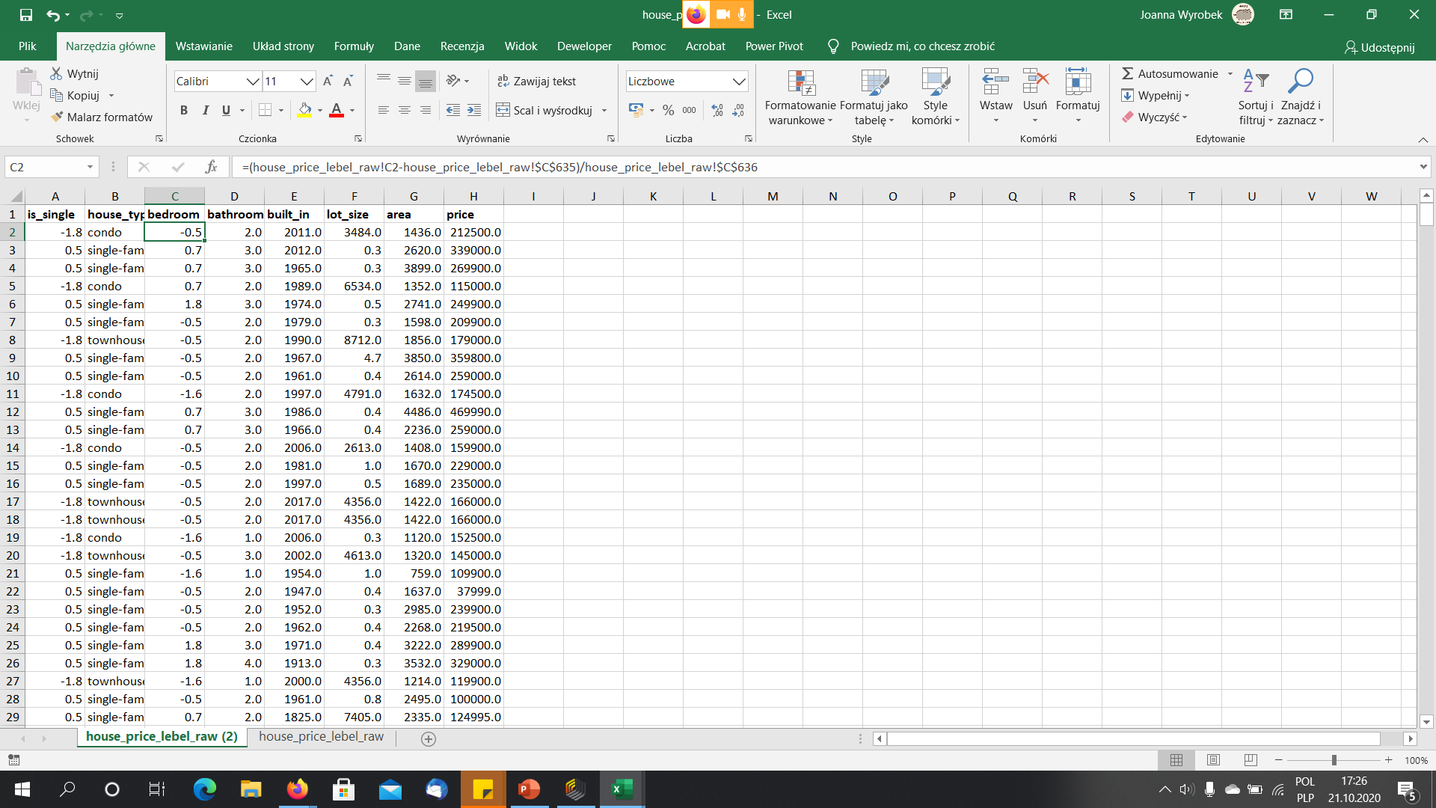
Apply standardization

Slide 47
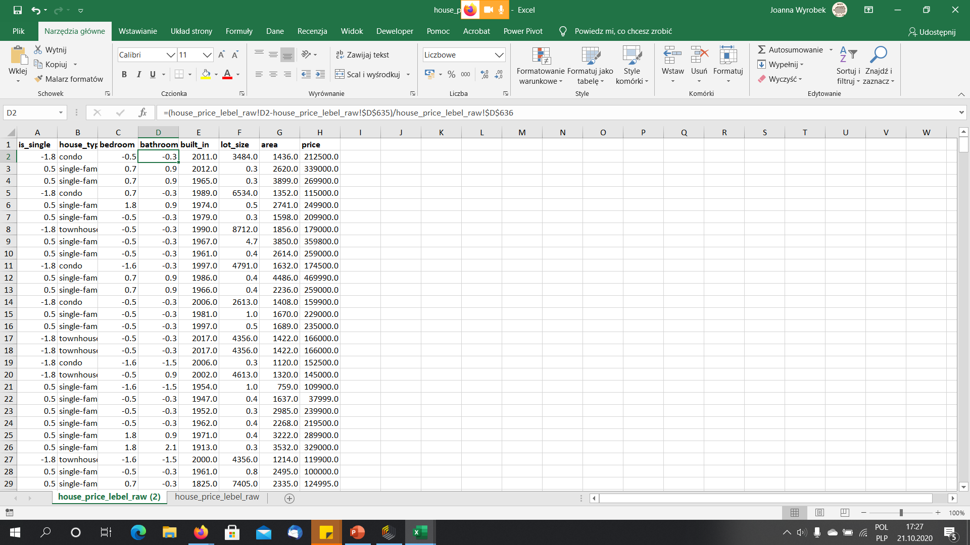
Apply standardization

Slide 48
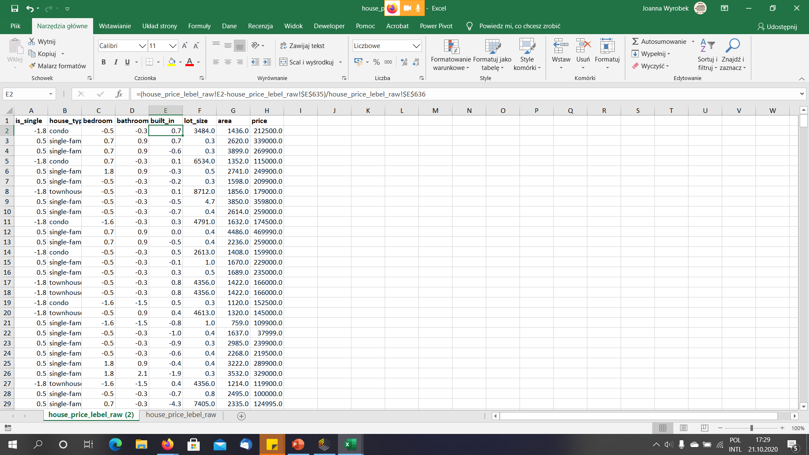
Apply standardization

Slide 49
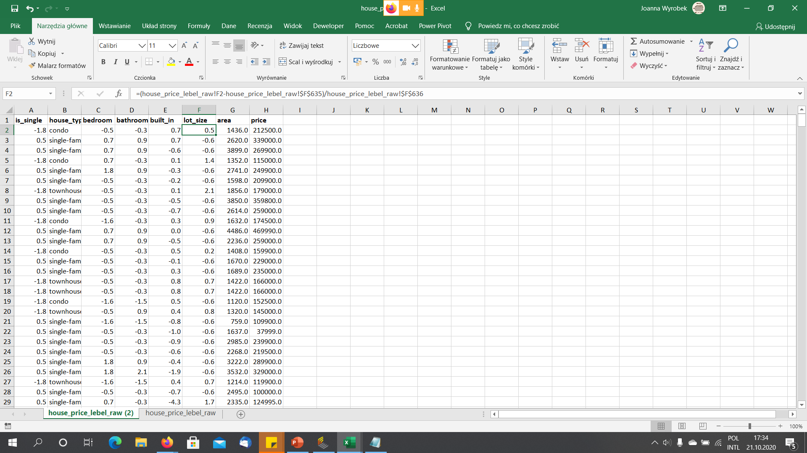
Apply standardization

Slide 50

Apply standardization

Slide 51
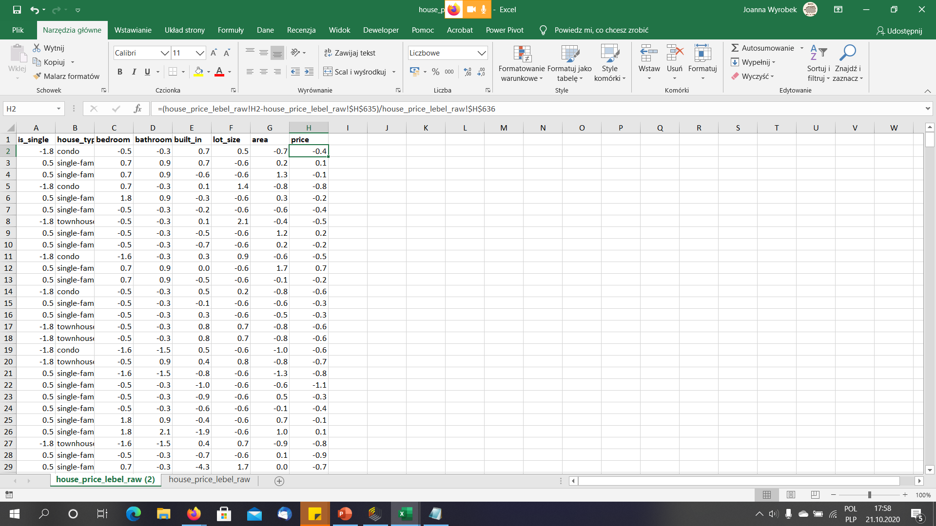
Apply standardization

Slide 52
Apply standardization
Copy and paste as values standardized observations
Import this data set into RapidMiner
Keep averages and standard deviations in the original spreadsheet, You will have to standardize all new data that You apply to the model

Slide 53
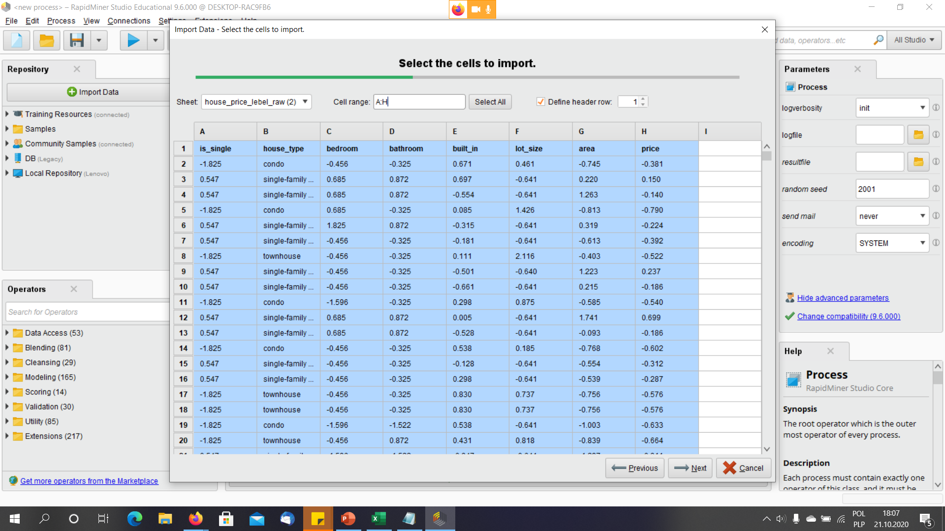
Import data

Slide 54
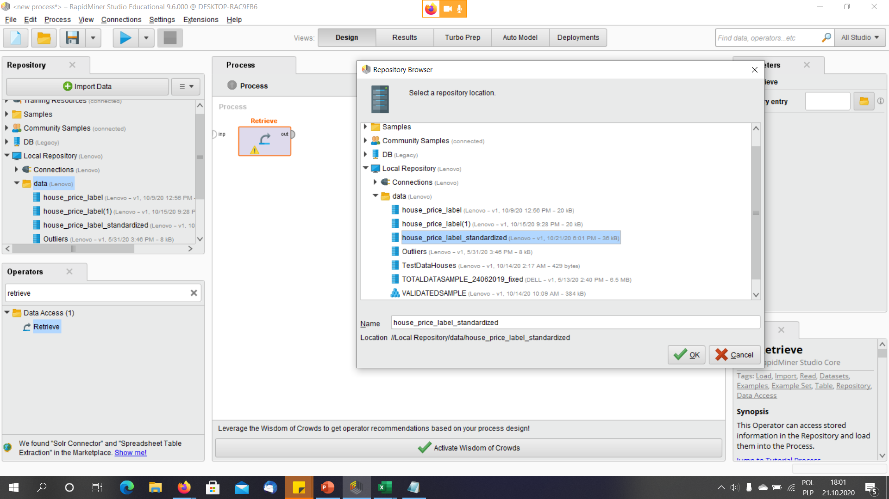
Drag and drop the retrieve operator (opens a file with data and send data further), choose house_price_label data set

Slide 55
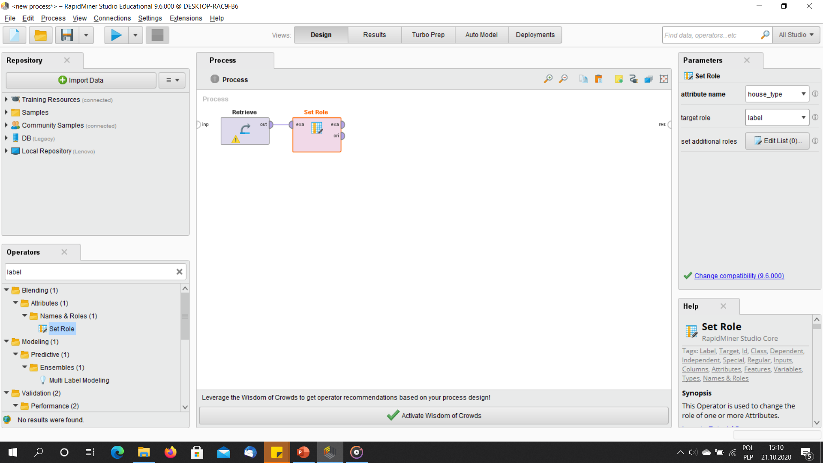
Drag and drop „set role” operator and set the role „label” to house_type attribute – because this column in the data set presents the actual classification of houses to different groups (classes)

Slide 56
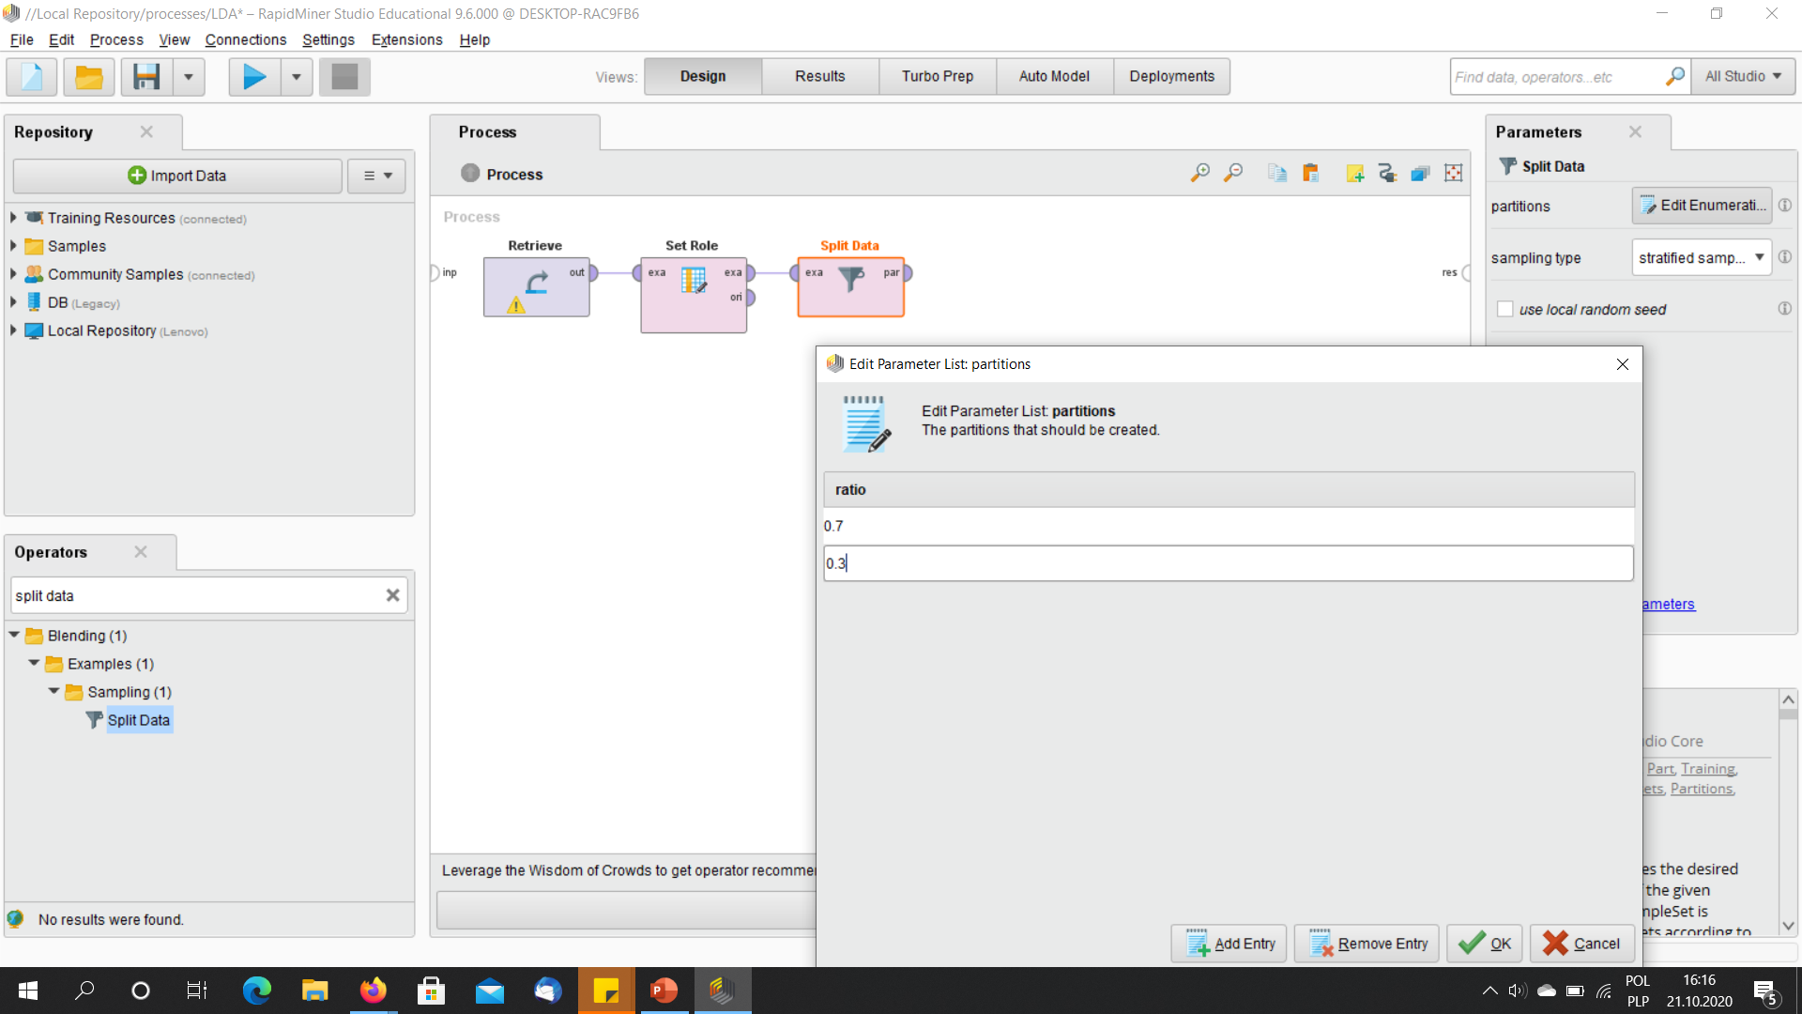
Drag and drop Split data operator because we want to train the model on one part of data set and test how well it works on the other part of the data set

Slide 57
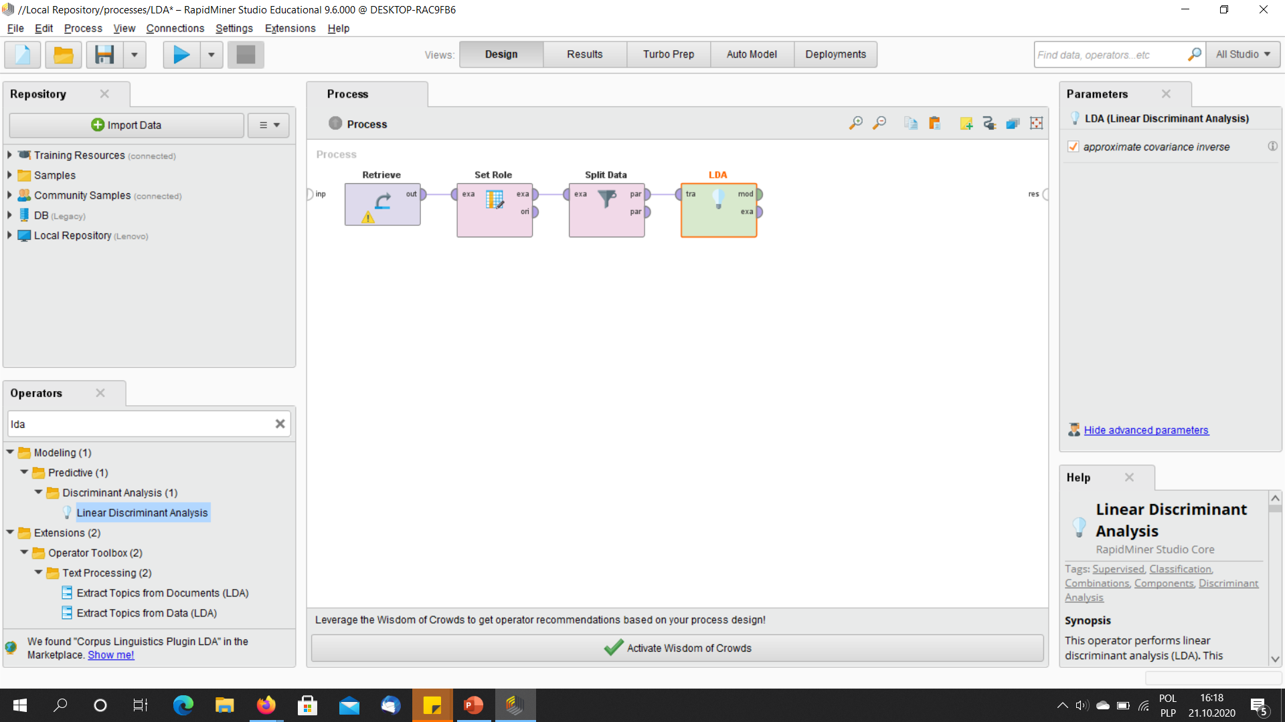
Drag and drop the LDA operator – this operator trains the LDA model (does calculations which You saw during the theoretical part of the lecture)

Slide 58
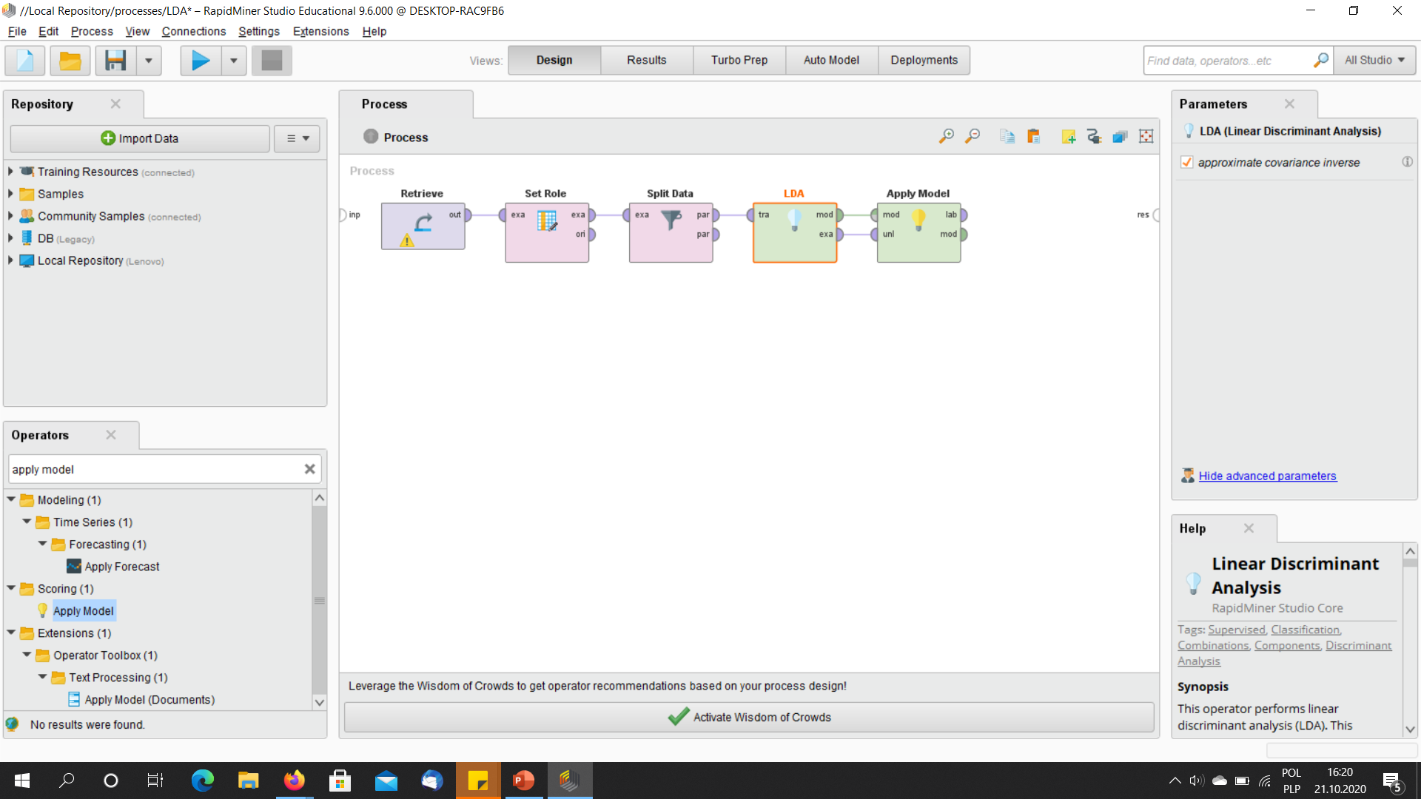
Drag and drop „Apply model” operator to pass the trained model to the next operator (performance operator in our case)

Slide 59
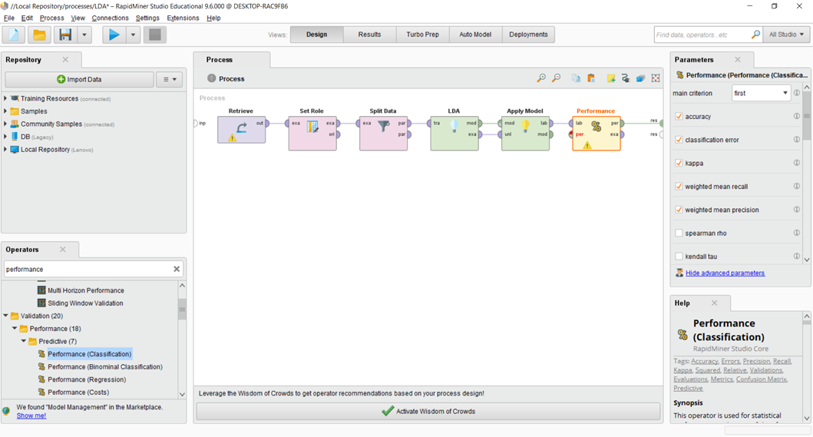
Drag and drop „Performance” operator to see how well the model worked on the training data

Slide 60
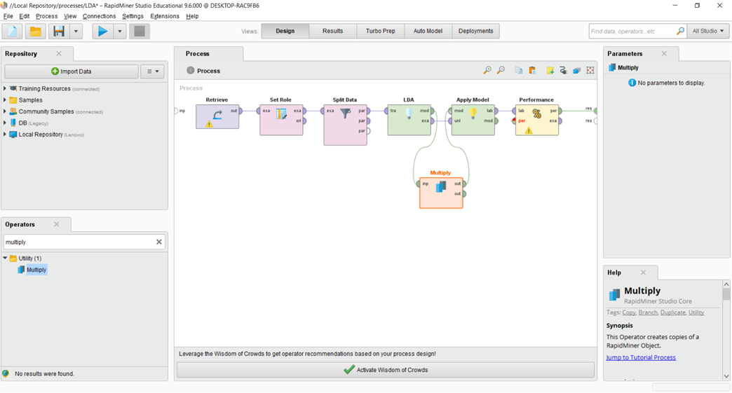
Drag and drop „Multiply” operator to multiply the model that we created (we need to pass it to 2 different operators)

Slide 61
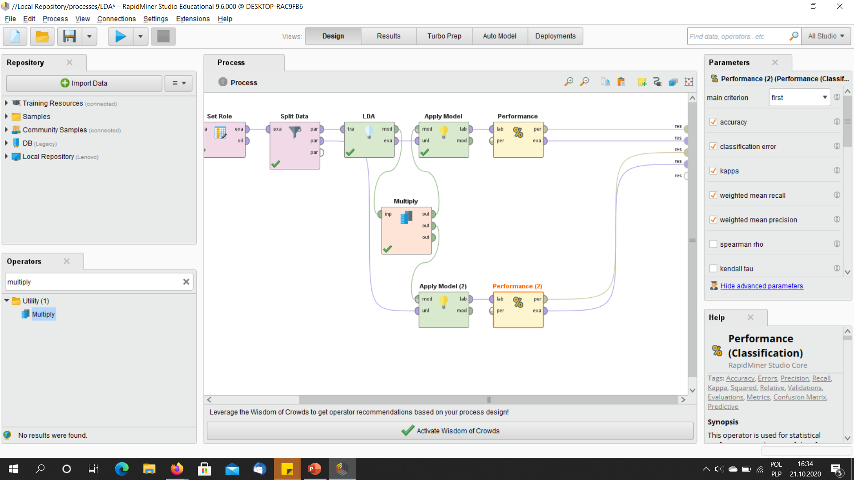
Copy and paste operators „Apply mode” and „performance”, then connect them to the „multiply operator” (which sends the trained model to tchem) and „split data” Operator (which sends to them the remaining part of the data sample). Then connect outputs of „performance” operators to the frame of the „design” windows so we will see the results.

Slide 62
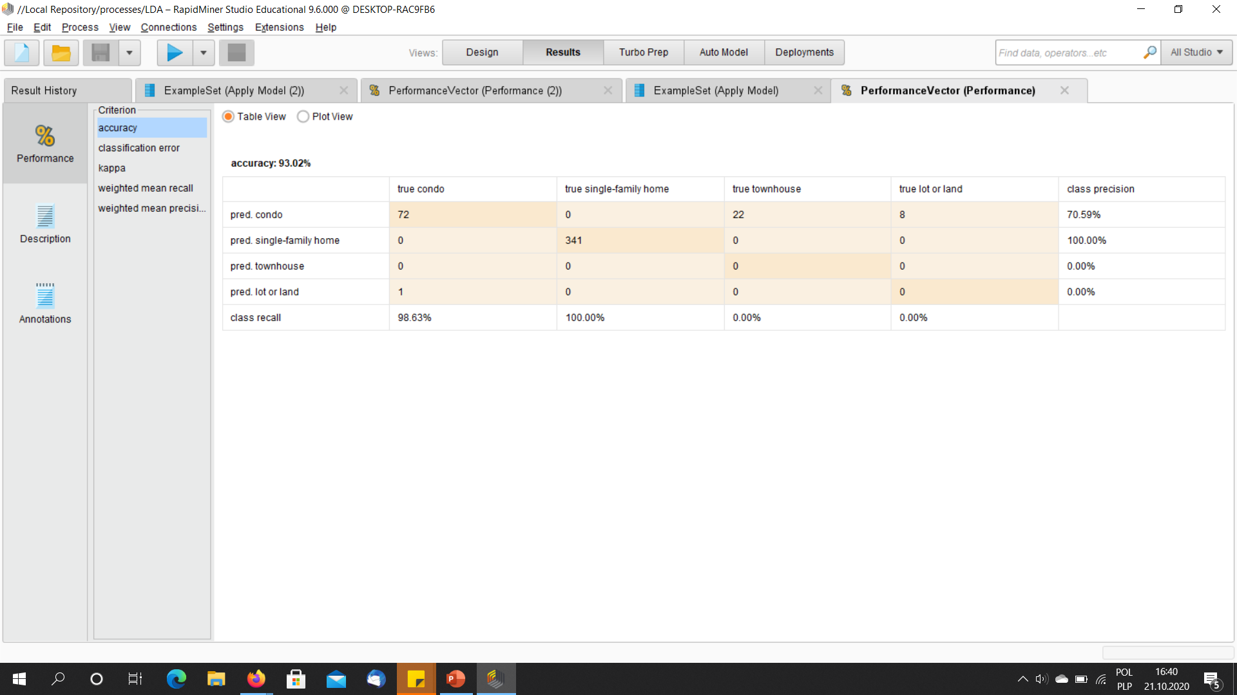
Performance for the training sample

Slide 63
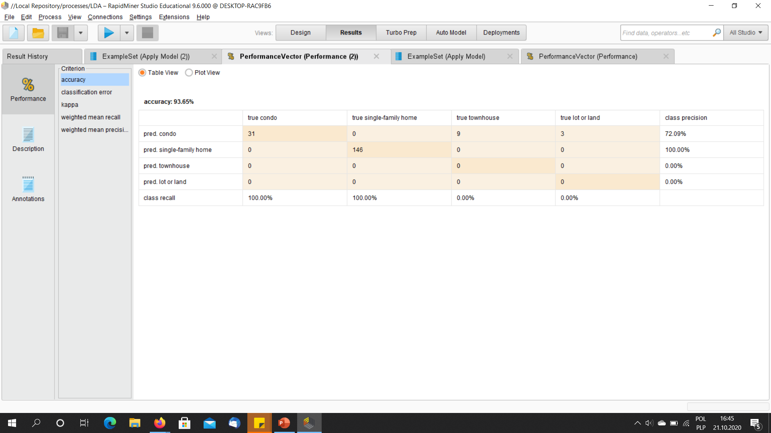
Performance for the validation sample

Slide 64
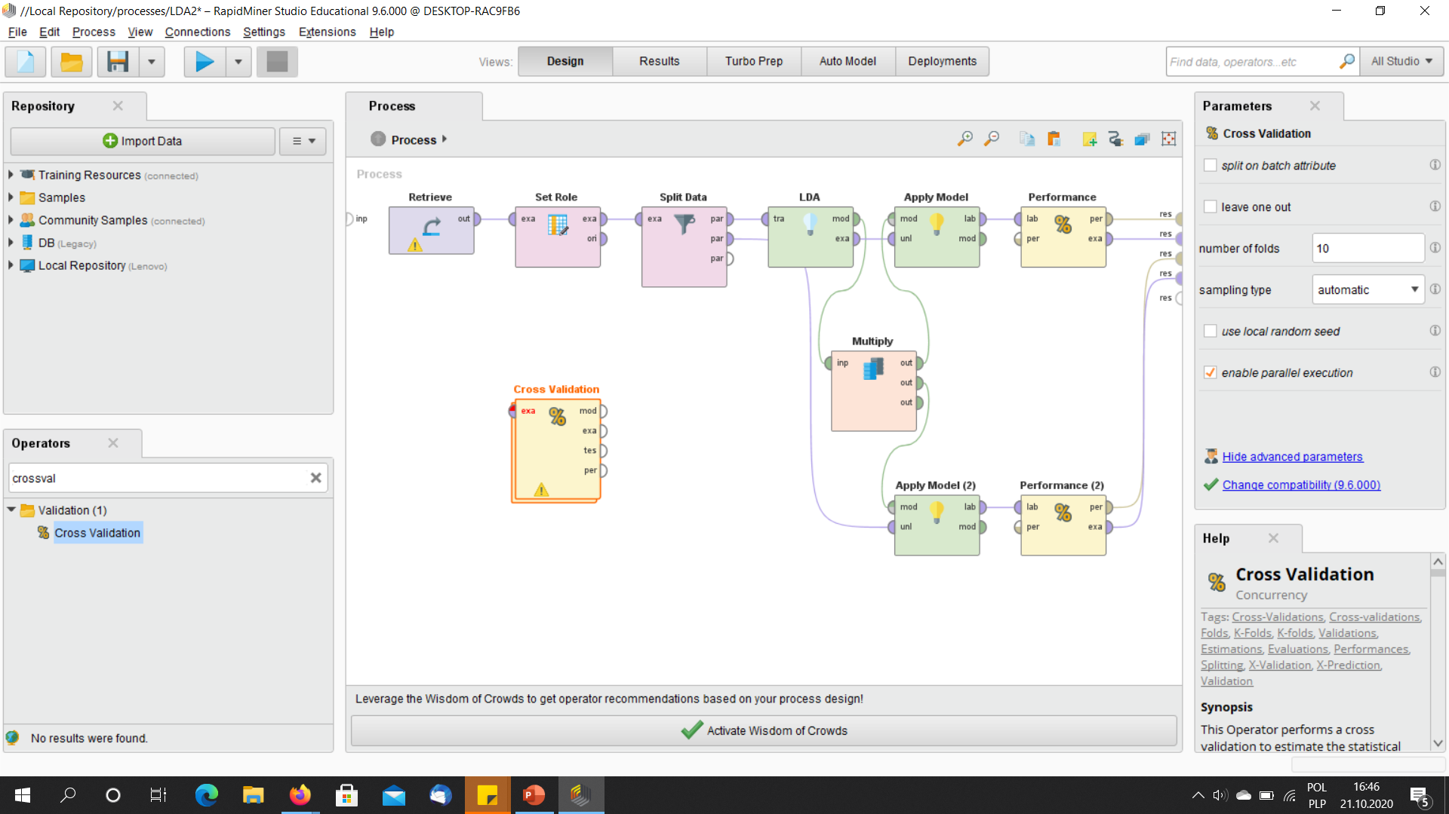
Drag and drop cross-validation operator – it divides the sample into a predefined by the uuser numer of parts (n) and takes each time only (n-1) numer of them for training, the last part is for model testing. It repeats this procedure n times and finally chooses the fittest model as the output.

Slide 65
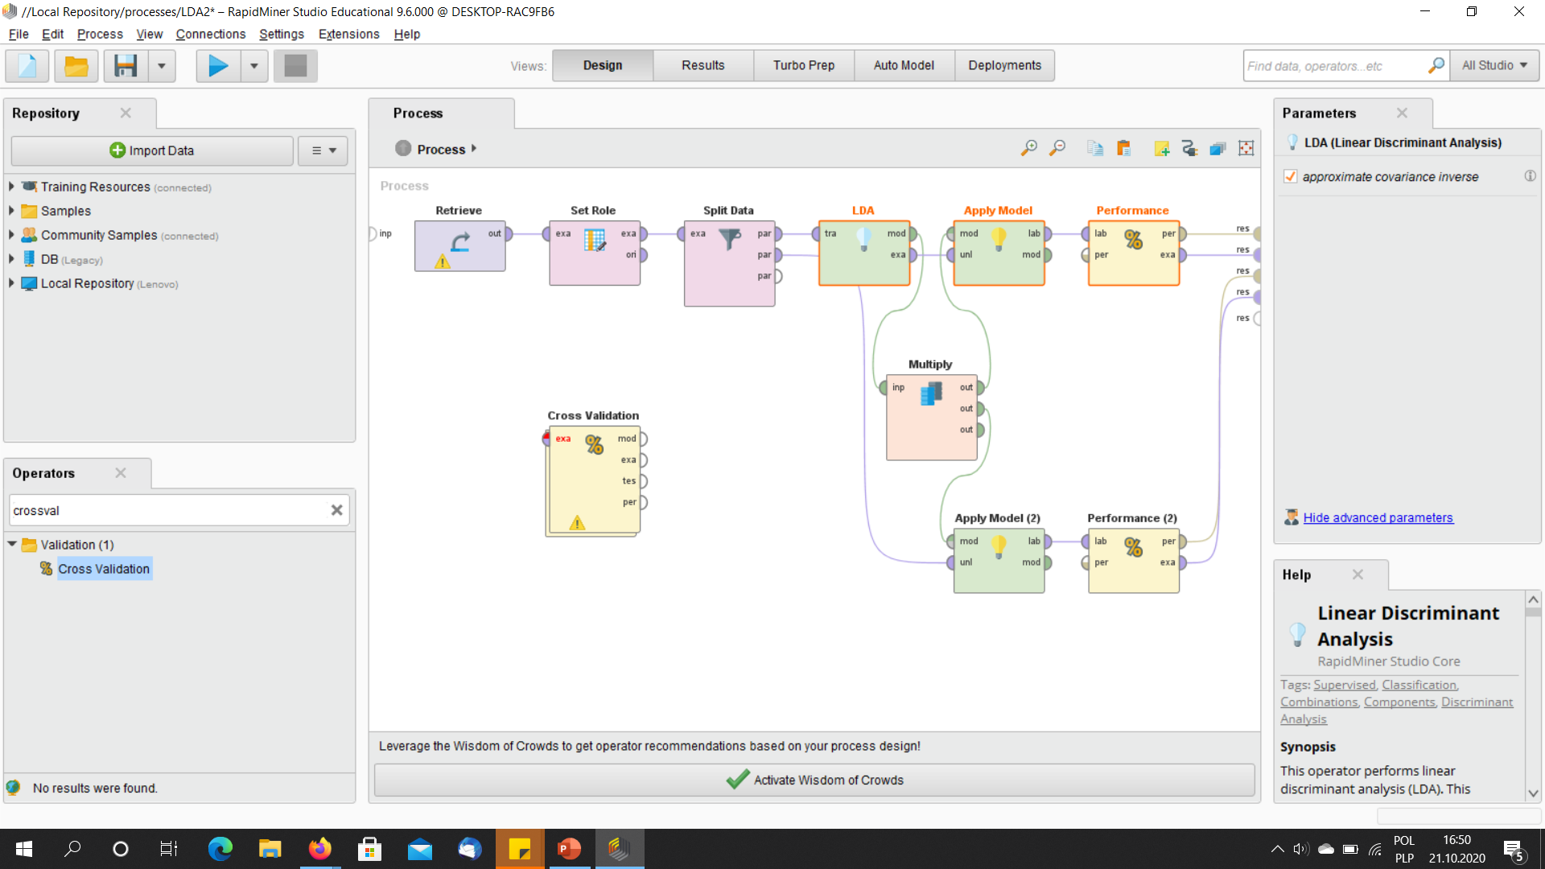
Select the operators „LDA”, „Apply model” and „Performance” and cut and paste tchem inside the cross-validation operator
Cut them and paste inside Cross-Validation Operator

Slide 66
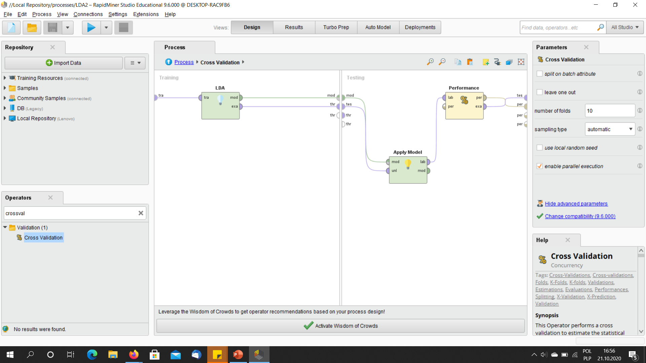
This is how You should connect them inside of Cross-Validation Operator – it has a separate sub-window for model training and for model-validation

Slide 67
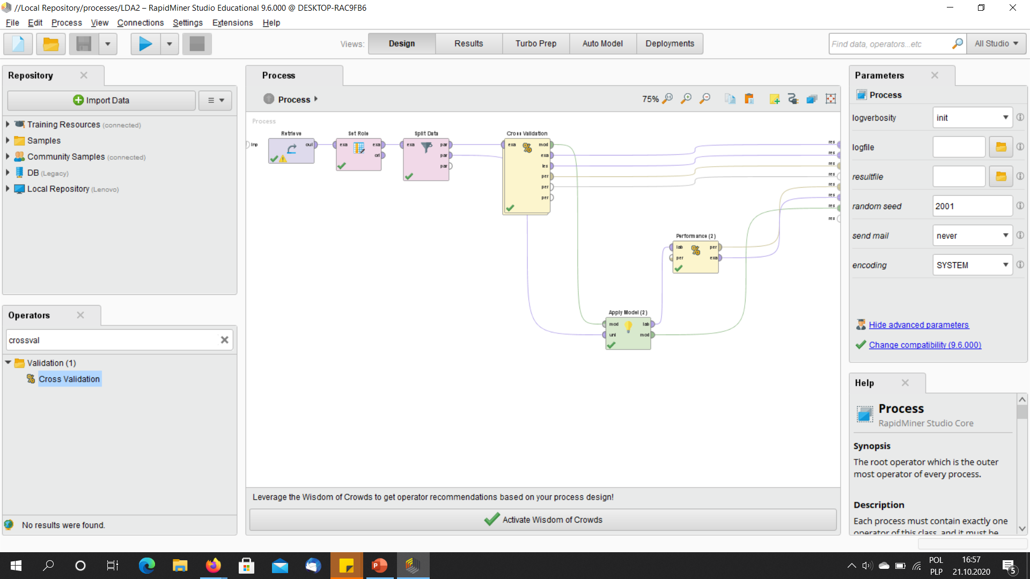
The proces on the top level

Slide 68
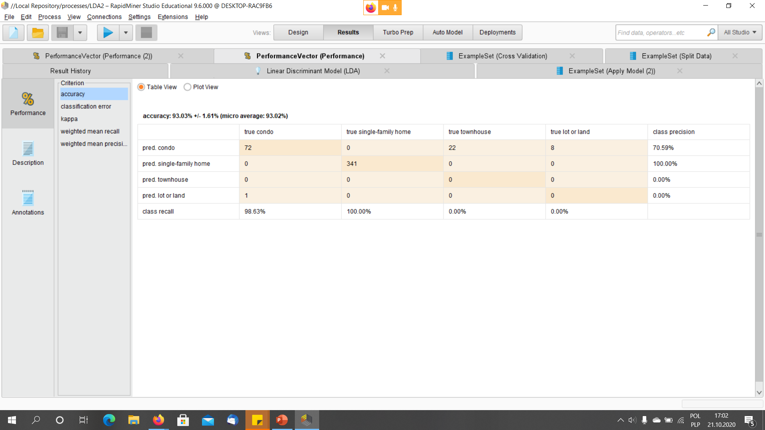
Performance for the training set

Slide 69
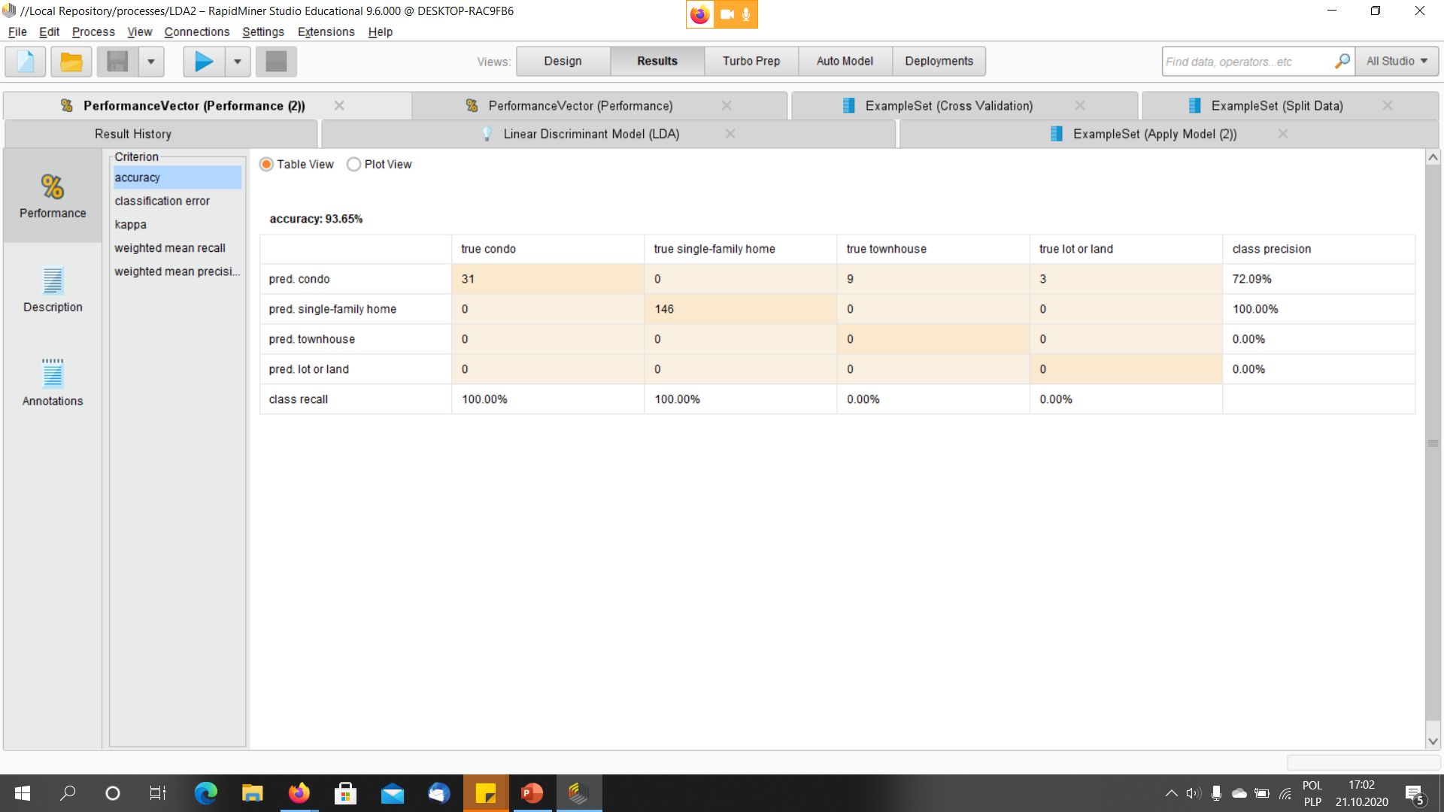
Performance for the validation set

Slide 70
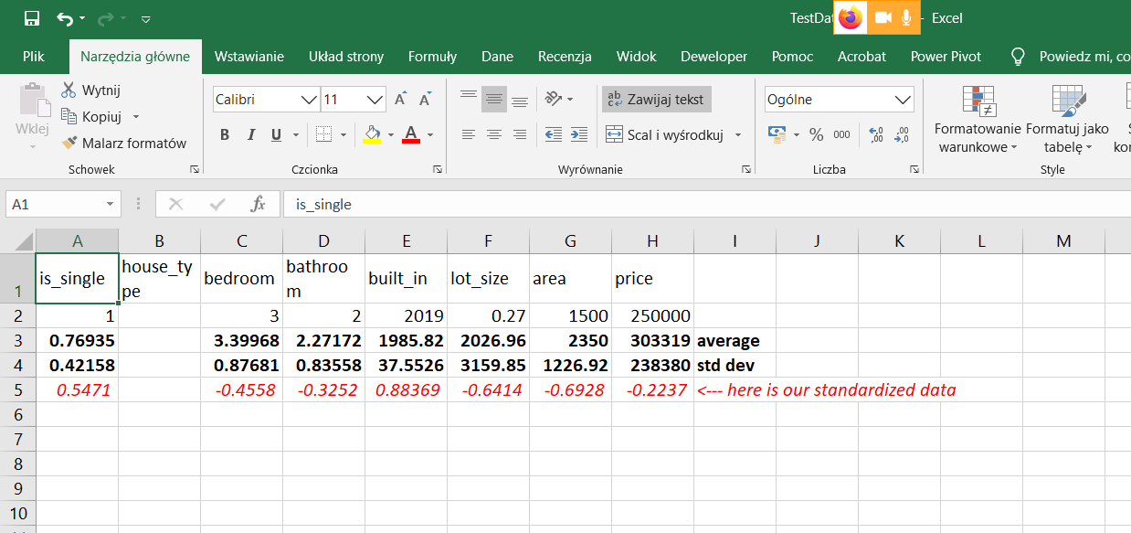
Now, let us use our model to classify a new observation – let us create it in Excel, remember to standardize it with the same averages and standard deviations as the original sample

Slide 71

Our standardized data

Slide 72

Import this data set into RapidMiner

Slide 73

Import this set into RapidMiner

Slide 74

Drag and drop an extra „Retrieve” operator

Slide 75

Drag and drop an extra „Set Role”,„Apply model” and „Performance” operators, use Multiply operator to multiply the model output

Slide 76

LDA returned its classification of the new observation

Slide 77
Now, let us try the same model with Iris data

Slide 78

Firstly, let us normalize the data and create a couple of new observation – open Iris data set in Rapid Miner – copy it and paste into Ms Excel

Slide 79

Firstly, let us normalize the data and create a couple of new observations – firstly standardization

Slide 80

Firstly, let us normalize the data and create a couple of new observations – firstly standardization

Slide 81

Firstly, let us normalize the data and create a couple of new observations – now, new observations in a separate file

Slide 82

Firstly, let us normalize the data and create a couple of new observations – now, new observations in a separate file

Slide 83

Now we import these files into RapidMiner

Slide 84

Now we import these files into RapidMiner

Slide 85

Now, plug these new data into our model

Slide 86

Now, plug the new data into the model

Slide 87

Remember to modify the „set role” operator

Slide 88

Performance for training sample

Slide 89

Performance for validation sample

Slide 90

Classification of new observations

